Slide 1
SnapDragon
T.Dharani (1818113)
K.Sowndarya(1818153)

Slide 2
Exp no:10 Find the Address space, First address, Last Address using subnetting in CIDR
AIM :
To write a Python program to calculate the
Address space, First Address and Last Address for
the given IP Address.

Slide 3
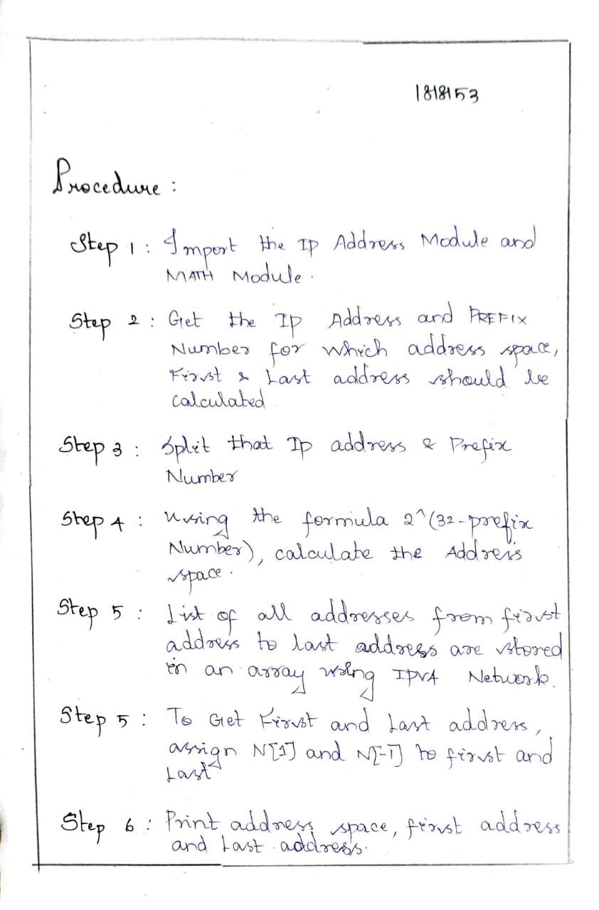
Procedure:

Slide 4
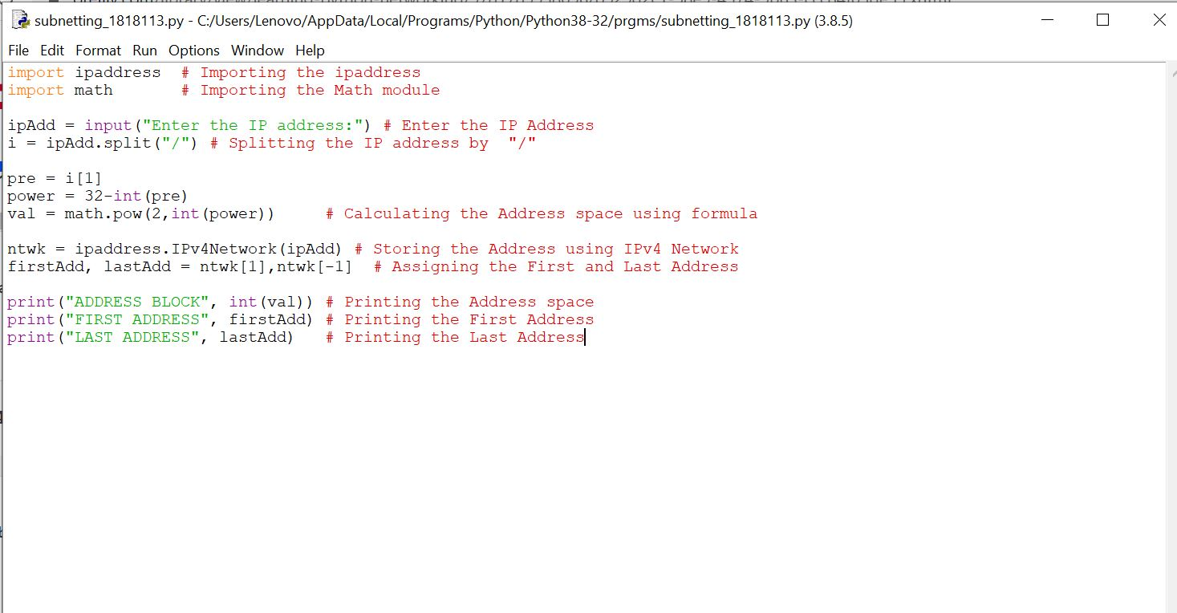
Program:

Slide 5
Output:

Slide 6
RESULT:
Thus, python program to calculate the Address space, First
Address and Last Address for the given IP Address was executed
successfully.

